Slide 1
Distributed Computing & Spark with Azure Databricks
Avanade ASG Data Science Bootcamp

Slide 2
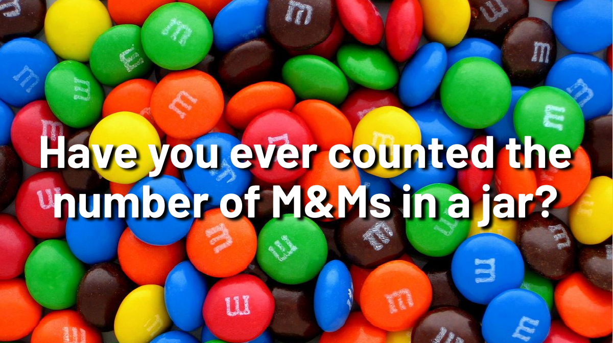
Motivation

Slide 3
Motivation

Slide 4
Scope & Objectives
Approach
It takes years of dedicated training to become a proficient Data Scientist. This is not the goal of the bootcamp. Instead, the goal is to give a high-level idea about what the field of Data Science entails, what Data Scientists do in their day-to-day work and to provide further resources for a continued learning journey
What will participants learn?
How to navigate comfortably in the applied and theoretical landscape of Data Science, Machine Learning, Statistics & Data Visualization
How to put skills into practice leveraging the Azure Ecosystem
How to set up a Data Science project from design/architecture to end of delivery
What is MLOps and how to productionize ML Models in Azure
Understand when a custom Data Science solution is needed and when Azure Cognitive Services can be used
Get to know about Avanade internal resources and accelerators
How to apply Data Science in a project team based on Avanade relevant industry use cases
What will participants not learn?
An overview of the Azure AI “out-of-the-box services” (Azure Cognitive Services) will be given but they will not be in the focus and therefore not explained in detail
Expert-level Data Science

